Slide 1
How to Stage ? Ovarian, Fallopian Tube, and Peritoneal Cancer
Jafari Shobeiri M.
Alzahra Hospital
Tabriz University of Medical Sciences
Tabriz,2020

Slide 2
Outline of this lecture
Overview
Pathology of Epithelial Invasive Cancer
Screening
Genetic Risk
Prophylactic Salpingo-oophorectomy
Initial Staging Surgery for Early Stage Carcinoma
Cytoreductive Surgery (Debulking) for Advanced-Stage Disease

Slide 3
Overview
Ovarian cancer is the second most common gynecologic cancer in the United States but it accounts for the majority of deaths from these cancers.
Classification:
1- Epithelial 2- Nonepithelial
Epithelial cancers: 90% are the most common ovarian/fallopian malignancy, and at initial diagnosis, over two-thirds of patients have advanced disease.
Nonepithelial malignancies of the ovary : 10% of all ovarian cancers

Slide 4
Overview
The peak age incidence of invasive epithelial
ovarian cancer is approximately 60 years.
lifetime risk of ovarian cancer is 1% to 1.5% .

Slide 5
Epithelial Ovarian Cancers Origin
previously thought to be derived from :
1- coelomic epithelium on the surface of the ovary or
2- ovarian inclusion cysts
It is now apparent that most serous carcinomas originate from the fallopian tube ,while other subtypes as clear cell and endometrioid are derived from endometriosis.

Slide 6
Pathology of Epithelial Invasive Cancer
Serous(75% - 80%)
endometrioid (10%),
clear cell (5%),
mucinous (5%),
transitional, and undifferentiated less than 1%

Slide 7
Screening?
The use of transvaginal ultrasound alone or in combination
with CA-125 for early ovarian cancer detection has not
proven effective in average-risk women to decrease mortality
from ovarian cancer, instead there are harms to this strategy,
including false-positive results and more invasive procedures
being performed such as surgery .

Slide 8
Genetic Risk and Ovarian Cancer?

Slide 9
Most epithelial ovarian cancers are sporadic, but up to one-quarter of cases may be associated with germline mutations in predisposing genes and may be hereditary.
Most hereditary ovarian cancers result from pathogenic mutations in either the BRCA1 or BRCA2 genes.
15% of women with high-grade nonmucinous ovarian cancers have germline mutations in BRCA1/BRCA2
40% of these women do not have a family history of breast/ovarian cancer
Hereditary ovarian, particularly caused by BRCA1 mutations :
younger age, typically about 10 years earlier than sporadic one.

Slide 10
Mutations are inherited : autosomal dominant
a full pedigree analysis (maternal and paternal) is essential when taking a family history.
All women with high-grade invasive ovarian cancers should be offered genetic testing, even if they do not have a family history of breast/ovarian cancer

Slide 11
Lynch II Syndrome or Hereditary Nonpolyposis Colon Cancer (HNPCC)
Includes combination of multiple adenocarcinomas : a of
- colon cancer,
- endometrial ,(16% -71%)
- ovarian cancer (11%-24%) and
- other malignancies of the gastrointestinal and genitourinary
The chief gene mutations in DNA Miss Match Repair Genes are associated with this syndrome include MSH2, MLH1, MSH6, and PMS2 or the EPCAM gene.

Slide 12
Prophylactic Salpingo-oophorectomy in High-Risk Women
Women with breast cancer who carry BRCA mutations are at a greatly increased risk of ovarian cancer and a second breast cancer:
lifetime risk of ovarian cancer:
- 54% for women who have a BRCA1 mutation
- 23% for those with a BRCA2 mutation,
- for the two groups together, there is an 82% of breast cancer
Prophylactic BSO in BRCA carriers reduced :
risk of BRCA-related gynecologic cancer by 96%
risk of developing subsequent breast cancer by 50% to 80%.

Slide 13
ACOG Recommendations
1--Genetic counseling is recommended:
a- all women with ovarian/fallopian tube/peritoneal epithelial cancer
b- individuals who have a personal or family history of breast cancer or
ovarian cancer.
2-- Screening in high risk women who wish to preserve fertility:
- transvaginal ultrasonography every 6 months or
- CA-125 measurement starting at age 30 to 35 years until they decide
to pursue definitive risk-reducing BSO.

Slide 14
ACOG Recommendations
3-- Women who do not wish to maintain their fertility
should be recommended to undergo prophylactic BSO:
after the age of 35 to 40 years for BRCA1 carriers with the
highest lifetime risk of ovarian cancer
BRCA2 carriers may consider delaying until age 40 to 45 years
because of later onset of ovarian cancer.
4-- Oral contraceptives should be recommended to young women

Slide 16
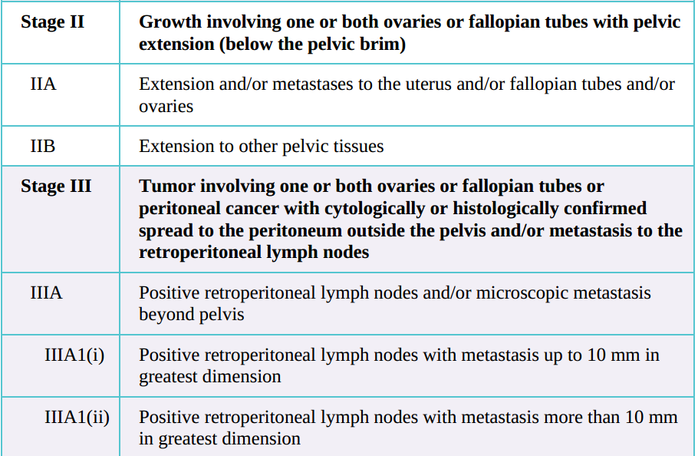

Slide 17
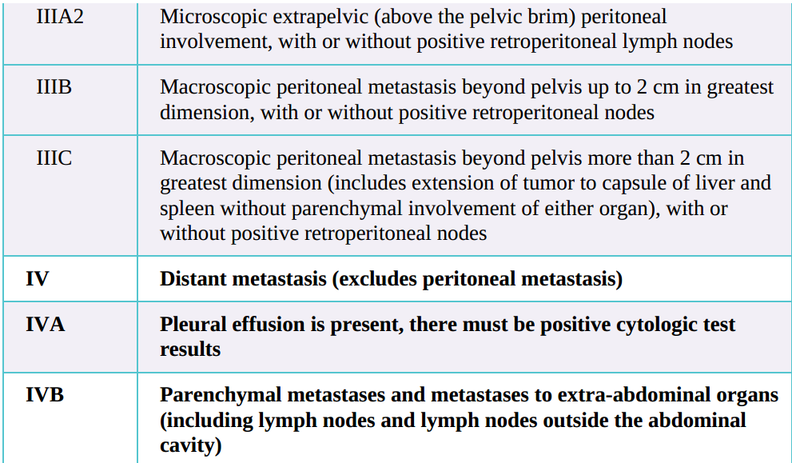

Slide 18
Type of Surgery in Ovarian Cancer
Staging Surgery for Primary Early Stage Disease (I , II)
Cytoreductive Surgery (Debulking) for Advanced-Stage Disease( III , IV)

Slide 19
Initial Staging Surgery for Primary Carcinoma of the Ovary, Fallopian Tube, or Primary Peritoneal Cancer
Epithelial malignancies are staged according to 2013 FIGO system
The FIGO staging is based on findings at surgical exploration.
A preoperative evaluation should exclude the presence of extrapelvic metastases.
Thorough surgical staging and search for microscopic metastasis should be performed when there is no visible or palpable disease in the intraabdominal space outside the ovaries and fallopian tubes.

Slide 20
Role of the gynecologic oncologist
Staging and initial surgical management should be
performed by a gynecologic oncologist whenever possible.
Outcomes of these procedures, when performed by a gynecologic oncologist, have been shown to be better than when the procedure is performed by other surgeons. successful operations are 70% to 90% by gynecologic oncologists .

Slide 21
Mode of Surgical Staging
1--Open laparotomy is the standard surgical approach.
2--Minimally invasive surgery (MIS) with traditional and robotic-assisted
laparoscopy has mainly been investigated in patients with presumed stage I
or II ovarian cancer in whom cytoreduction is not necessary .
MIS approach is controversial and requires further investigation before use becomes widespread.
Disadvantages:
1 - rupture of the mass may worsen prognosis
2 - Thorough inspection of the entire pelvis and abdomen, especially
inspection of all bowel surfaces and mesentery, is challenging.
3- Tumor seeding of the laparoscopic access sites (port site metastasis)
may occur.

Slide 22
Technique for Surgical Staging
vertical abdominal incision is recommended to allow adequate access to the upper abdomen .
When a malignancy is unexpectedly discovered in a patient who has a lower transverse incision:
a - the rectus muscles can be either divided ( maylard) or
b - detached from the symphysis pubis (chernney)
c - If this is not sufficient, the incision can be extended on one side
to create a “J” incision .
The ovarian tumor should be removed intact, if possible, and a frozen histologic section should be obtained.

Slide 23
Capsule rupture
- Preoperatively
- Intraoperative during surgical removal and may disseminate
malignant cells via the peritoneal circulation .This is reflected in the
staging system: for stage I disease, surgical spill is IC1, and rupture
prior to surgery is IC2. Patients with disease confined to one or both
ovaries who have intraoperative capsule rupture are upgraded from IA
or IB to IC1.
It is clinically significant because stage IC is typically the threshold for treating with chemotherapy for certain histologies.

Slide 24
Thorough steps of surgical staging
1. Any free fluid, especially in the pelvic cul-de-sac, should be submitted for cytologic evaluation.
2. If no free fluid is present, peritoneal washings should be performed by instilling and recovering 50 to 100 or 200 mL of saline from the pelvic cul-de-sac, each paracolic gutter, and beneath each hemidiaphragm. Obtaining the specimens from under the diaphragms can be facilitated with the use of a rubber catheter attached to the end of a bulb syringe.
A systematic exploration of all the intra-abdominal surfaces and viscera is performed.

Slide 25
4. Any suspicious areas or adhesions on the peritoneal surfaces should be
biopsied. Dense adhesions in stage I with histologically proven neoplastic cells
justify upgrading to stage II.
If there is no evidence of disease, multiple peritoneum biopsies :
- pelvic cul-de-sac,
- both paracolic gutters,
- pelvic side wall ,
- over the bladder,
- both hemidiaphragm and
- intestinal mesenteries should be taken
5.The diaphragm should be sampled, either by biopsy or by scraping with a tongue depressor, and a sample obtained for cytologic assessment. Biopsies of any irregularities on the surface of the diaphragm can be facilitated by the use of the laparoscope and the associated biopsy instrument.

Slide 26
Omentectomy
6. Omentum should be resected from the transverse colon, including from the hepatic and splenic flexure of the colon and separated from its attachment to the greater curvature of the stomach, including ligation of the left and right gastroepiploic and short gastric arteries, a procedure called supracolic omentectomy. The procedure is initiated on the underside of the greater omentum, where the peritoneum is incised a few millimeters away from the transverse colon. The branches of the gastroepiploic vessels are clamped, ligated, and divided, along with all the small branching vessels that feed the infracolic omentum.
Resection of the omentum, with metastatic disease (omental cake), may be performed even when optimal cytoreduction is not possible in order to decrease tumor bulk and formation of postoperative ascites

Slide 27
lymphadenectomy
7. The retroperitoneal spaces should be explored to evaluate the pelvic and para-aortic lymph nodes.
The retroperitoneal dissection is performed by incision of the peritoneum over the psoas muscles. Any enlarged lymph nodes should be resected and submitted for frozen section. If no metastases are present, a formal pelvic lymphadenectomy should be performed.
The paraaortic area should be palpated and lymph nodes sampled if enlarged or suspicious.

Slide 28
lymphadenectomy
one-third of patients with apparent stage I has node metastesis.
pelvic and paraaortic lymph node sampling is performed to detect occult stage III
Though lymph node sampling is associated with:
- increased duration of surgery and
- 13 % risk of lymphocyst formation
failure to detect nodal disease can have major prognostic implication.
An exception to routine lymph node sampling is patients with apparent early disease with mucinous tumors (3 % of EOC) that appear confined to the ovary. the rate of lymph node metastases was 0.7 %, and no survival difference was noted in those with and without lymph node sampling .

Slide 29
Appendectomy
If the appendix is involved with tumor, then an appendectomy should be performed.
Experts perform routine appendectomy if mucinous histology is a concern . since complications are rare and a normal-looking appendix does not exclude metastatic disease .
With mucinous ovarian tumors found :
- metastatic disease to the appendix or
- primary appendiceal cancer was relatively common:

Slide 30
Hysterectomy and salpingo-oophorectomy
TAH + BSO are performed in almost all patients .
Fertility preservation : unilateral salpingo-oophorectomy + staging.
The rationale for TAH + BSO :
1- remove (if present) occult metastases in the contralateral ovary,
adnexa, or uterus.
2-Occasionally, a synchronous primary endometrial cancer will be
present, or the uterus will be the site of origin of the suspected
EOC

Slide 31
staging in patients who desire fertility preservation
unilateral salpingo-oophorectomy +
full surgical staging +
endometrial biopsy to exclude synchronous endometrial cancer.
Fertility preservation in young patients with :
- low malignant potential (Borderline Tumors) or
- nonepithelial ovarian cancers and
- stage IA EOC

Slide 32
Surgery for Advanced stage Cancers (III, IV)

Slide 33
Cytoreductive Surgery (Debulking)
In medically stable , cytoreductive surgery to remove as much of the primary tumor and its metastases as possible should be is referred to as debulking or cytoreductive surgery.
The operation includes :
TAH-BSO +
Complete omentectomy ,
Resection of any metastatic lesions.
The removal of bulky tumor masses may reduce the volume of ascites present.

Slide 34
Cytoreductive Surgery (Debulking) lymphadenectomy?
Routine systematic lymphadenectomy in patients with advanced ovarian cancer and clinically and radiographically negative nodes should be omitted, as no overall survival benifit.

Slide 35
Cytoreductive Surgery ( Debulking )
If resection of all metastases is not feasible, the goal is to reduce the tumor burden by resection of all individual tumors to an Optimal status ( <1cm of any single implant of residual disease ).
Patients whose disease is completely resected to no macroscopic (microscopic only) residual disease have best overall survival :
free of disease at 5 years = 30% to 40%.
If optimal cytoreduction is not considered achievable, extensive bowel and urologic resections are not indicated, except to overcome a bowel obstruction.

Slide 36
Cytoreductive Surgery (Debulking ) Intestinal Resection?
Intestinal Resection of focal metastesis of small or large intestine should be performed if that would permit the removal of all or most of the abdominal metastases and leave the patient with optimal cytoreduction at the end of surgery:
Resection of one or more of these segments of bowel
may be necessary .

Slide 37
Outcome
All retrospective studies indicate that the largest diameter of the residual tumor before the initiation of chemotherapy is significantly related to the PFS in patients with advanced ovarian cancer.
The quality of life may be significantly enhanced by the removal of bulky tumor masses from the pelvis and upper abdomen .

Slide 38
In Summary
Screening by transvaginal ultrasound alone or in combination with CA-125 for early ovarian cancer detection has not proven effective
Most hereditary cancers result from mutations in BRCA1 or BRCA2 genes.
Genetic counseling is recommended for all women with ovarian/fallopian tube/peritoneal epithelial cancer
Prophylactic BSO in high- risk reduces :gynecologic cancer by 96% and breast cancer by 50% to 80%.
Staging Surgery for Primary early Carcinoma (I , II)
Cytoreductive Surgery (Debulking) for Advanced-Stage Disease( III , IV)

Slide 39
Thank You for your attention

